Slide 2
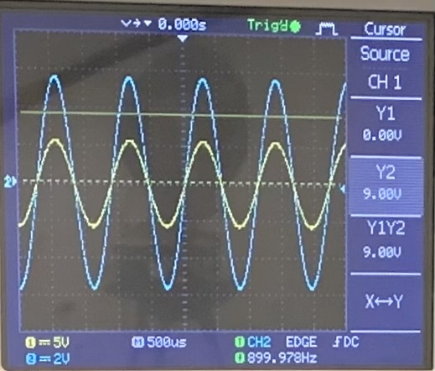
Problem Statement
The responses of a LRC circuit driven by an AC source can be changed by inserting either a non-magnetic metal rod or a ferromagnetic rod into the inductor coil. How can we obtain the magnetic and electric properties of the inserted rod from the circuit’s responses?

Slide 3
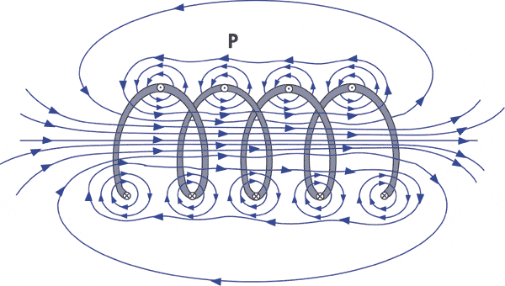
Basic physics
Inductor coil + AC current → changing magnetic field (magnetic induction)
Inserted rod interacts with this field
extra currents generate
magnetic field weakens/strengthens
Properties of the inductor change
Process:
measure the steady-state response of the circuit
circuit theory → acquire the properties of the inductor
electromagnetic theory → calculate the properties of the rod
coil1.gif (600×340) (nde-ed.org)
Notes:
electromagnetic phenomenons happen

Slide 4
I. LRC theory

Slide 5
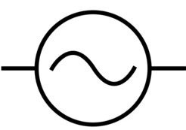
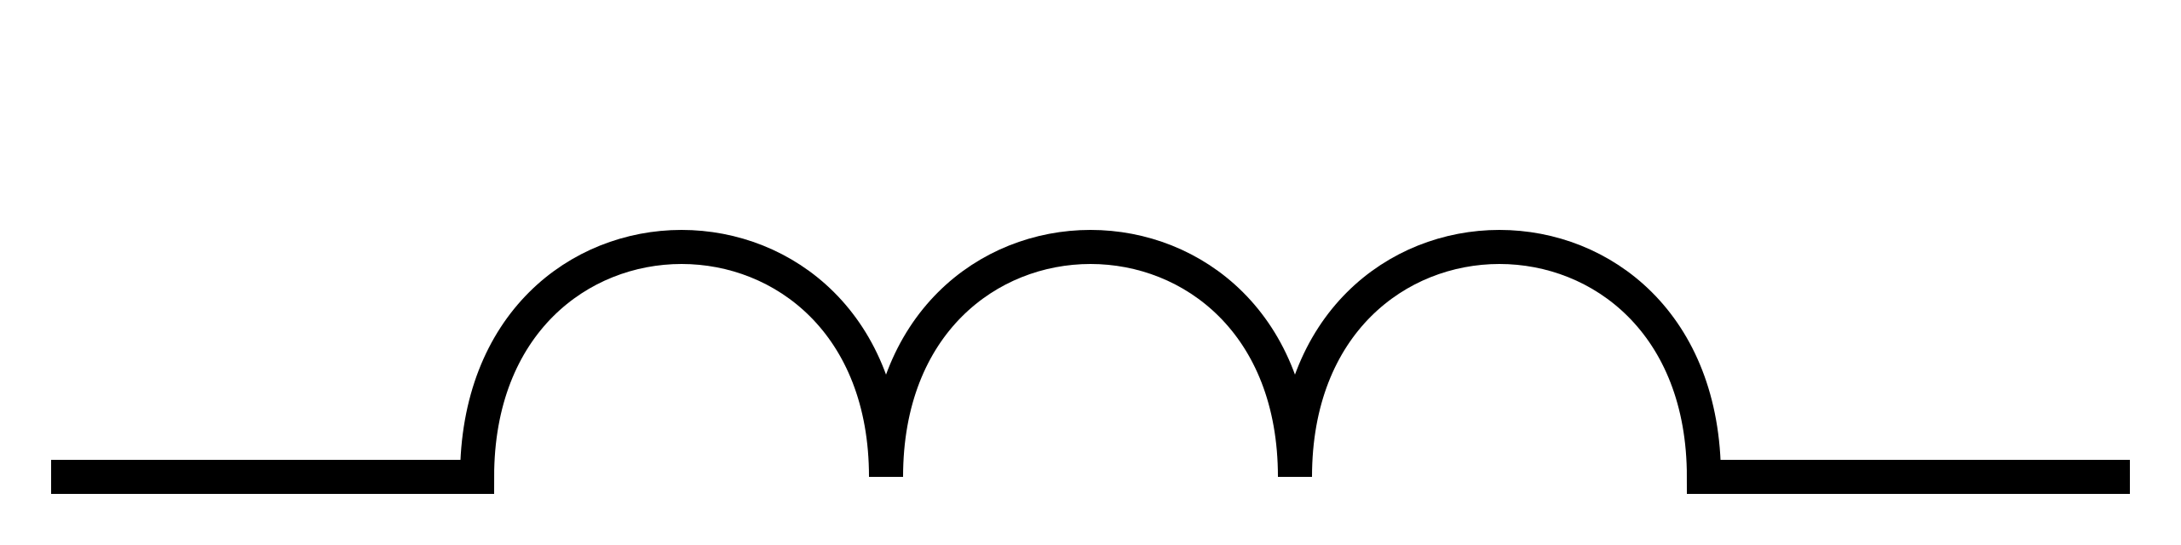
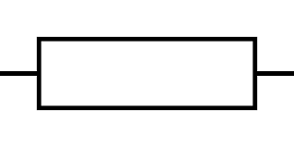
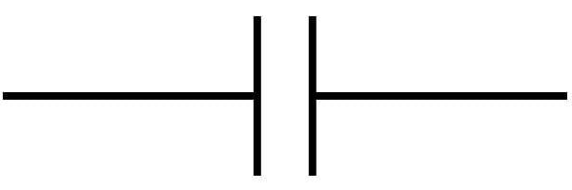


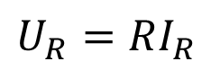

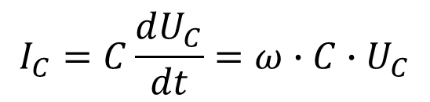

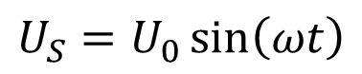
LRC circuit components
Driving AC voltage:
Inductor:
resists the change of current
voltage goes in front of current ($φ=90°$)
Resistor:
no phase difference between U and I
Capacitor:
resists the change of voltage
voltage lags behind current ($φ=−90°$)
$$U_{S}=U_{0}\sin\left(ωt\right)$$
$$U_{L}=L\frac{dI_{L}}{dt}=ω∙L∙I_{L}$$
$$X_{L}=ωL$$
$$U_{R}=RI_{R}$$
$$I_{C}=C\frac{dU_{C}}{dt}=ω∙C∙U_{C}$$
$$X_{C}=\frac{1}{ωC}$$
changes when inserting the rod
Notes:
reactance – resistance-like property

Slide 6
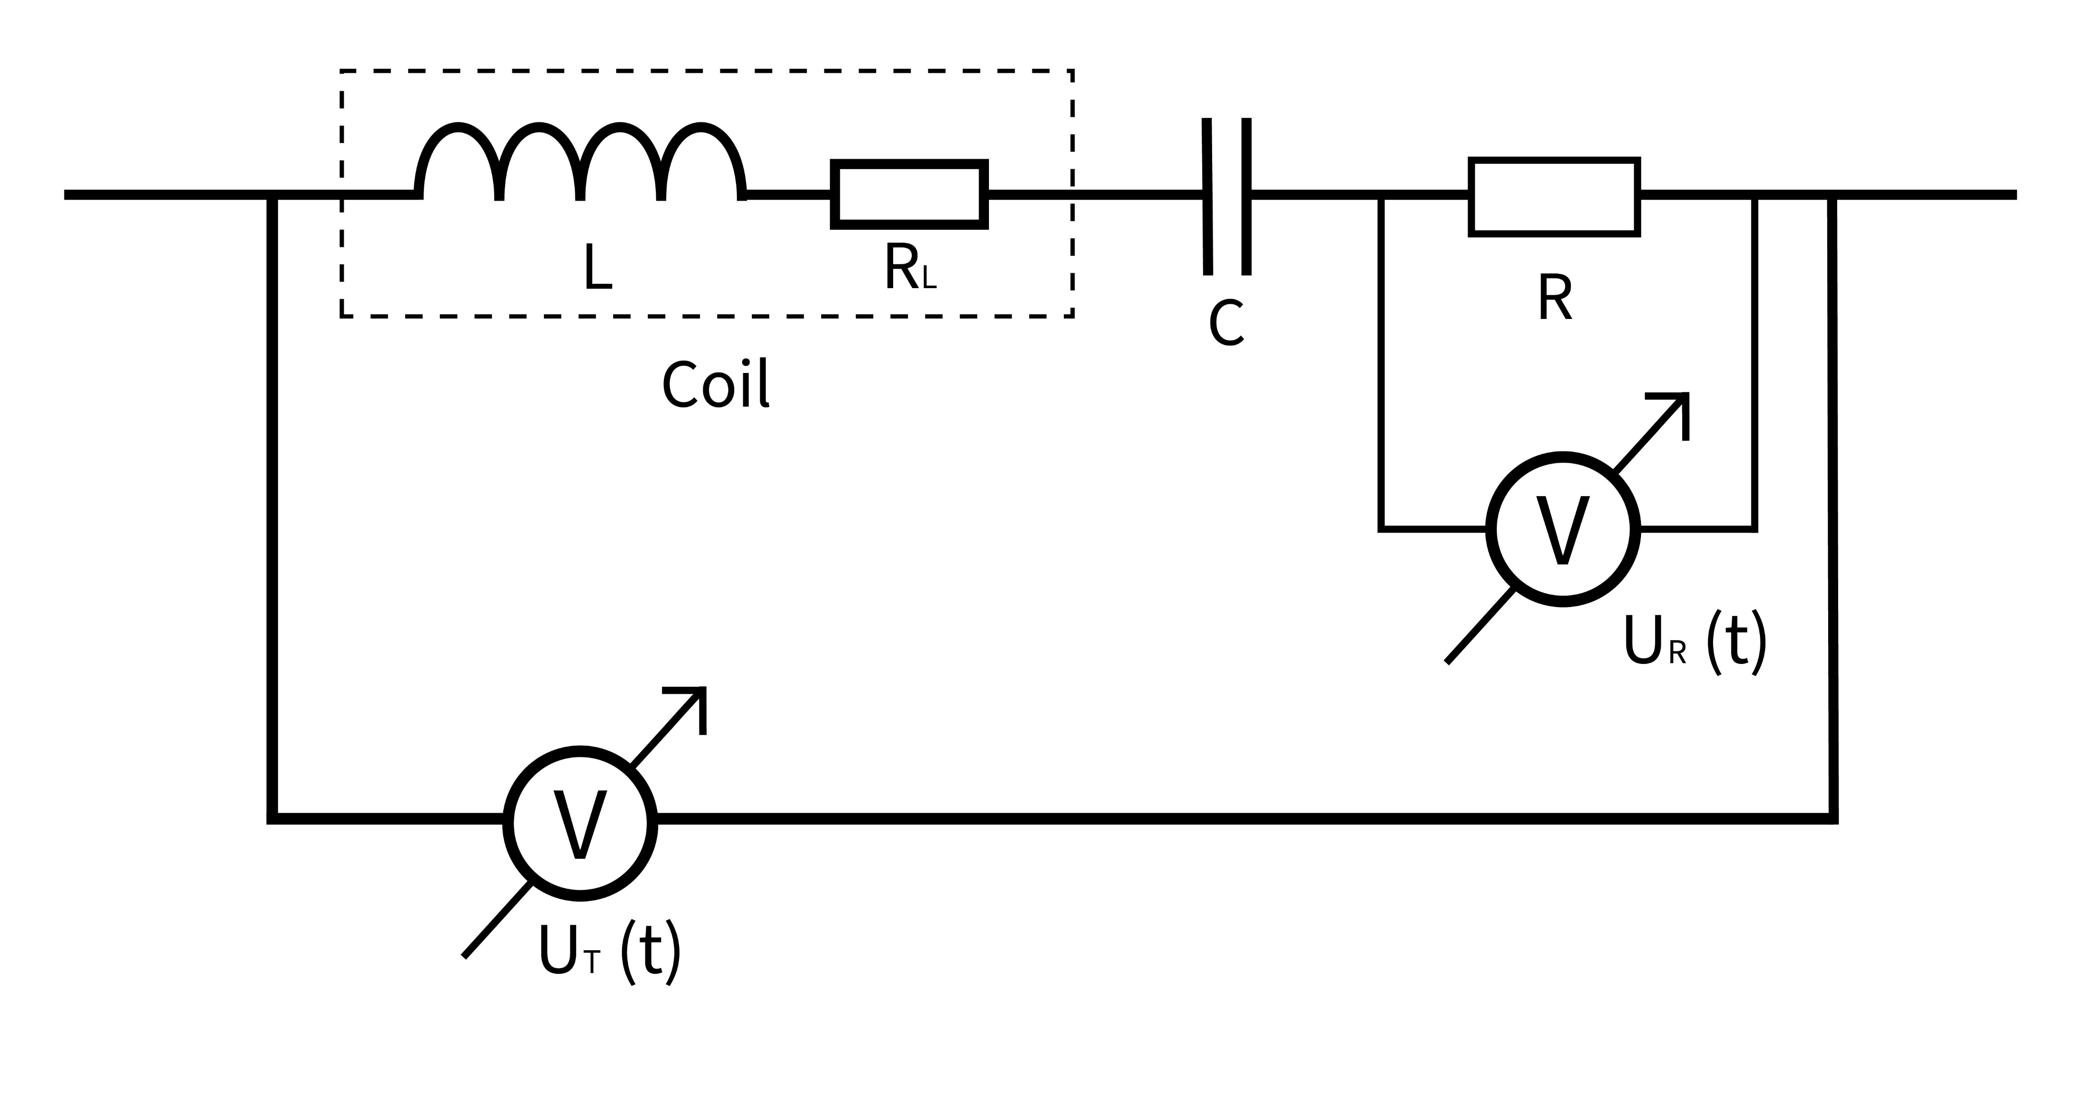
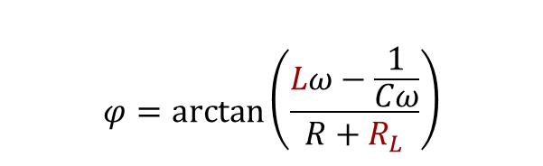
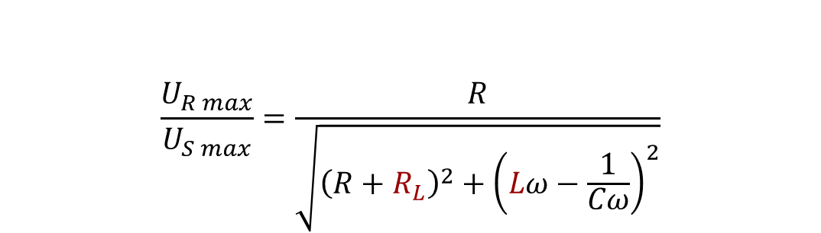
Circuit diagram
changing parameters
$$\frac{U_{R max}}{U_{S max}}=\frac{R}{\sqrt{{\left(R+R_{L}\right)}^{2}+{\left(Lω−\frac{1}{Cω}\right)}^{2}}}$$
S
Ohm’s law
$$φ=arctan⁡\left(\frac{Lω−\frac{1}{Cω}}{R+R_{L}}\right)$$
geometry
Notes:
táp !!!

Slide 7
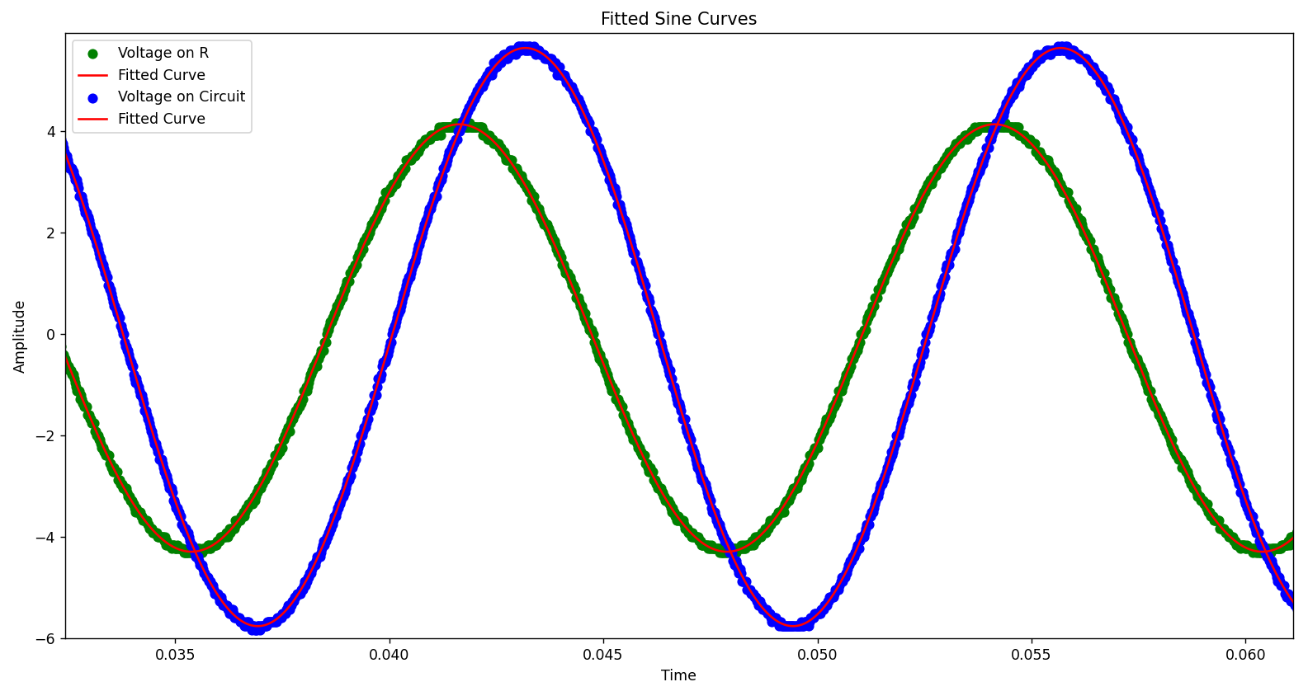



Circuit response
$$U_{S max}$$
$$φ$$
$$U_{R max}$$
Notes:
measured through a frequency spectrum

Slide 8
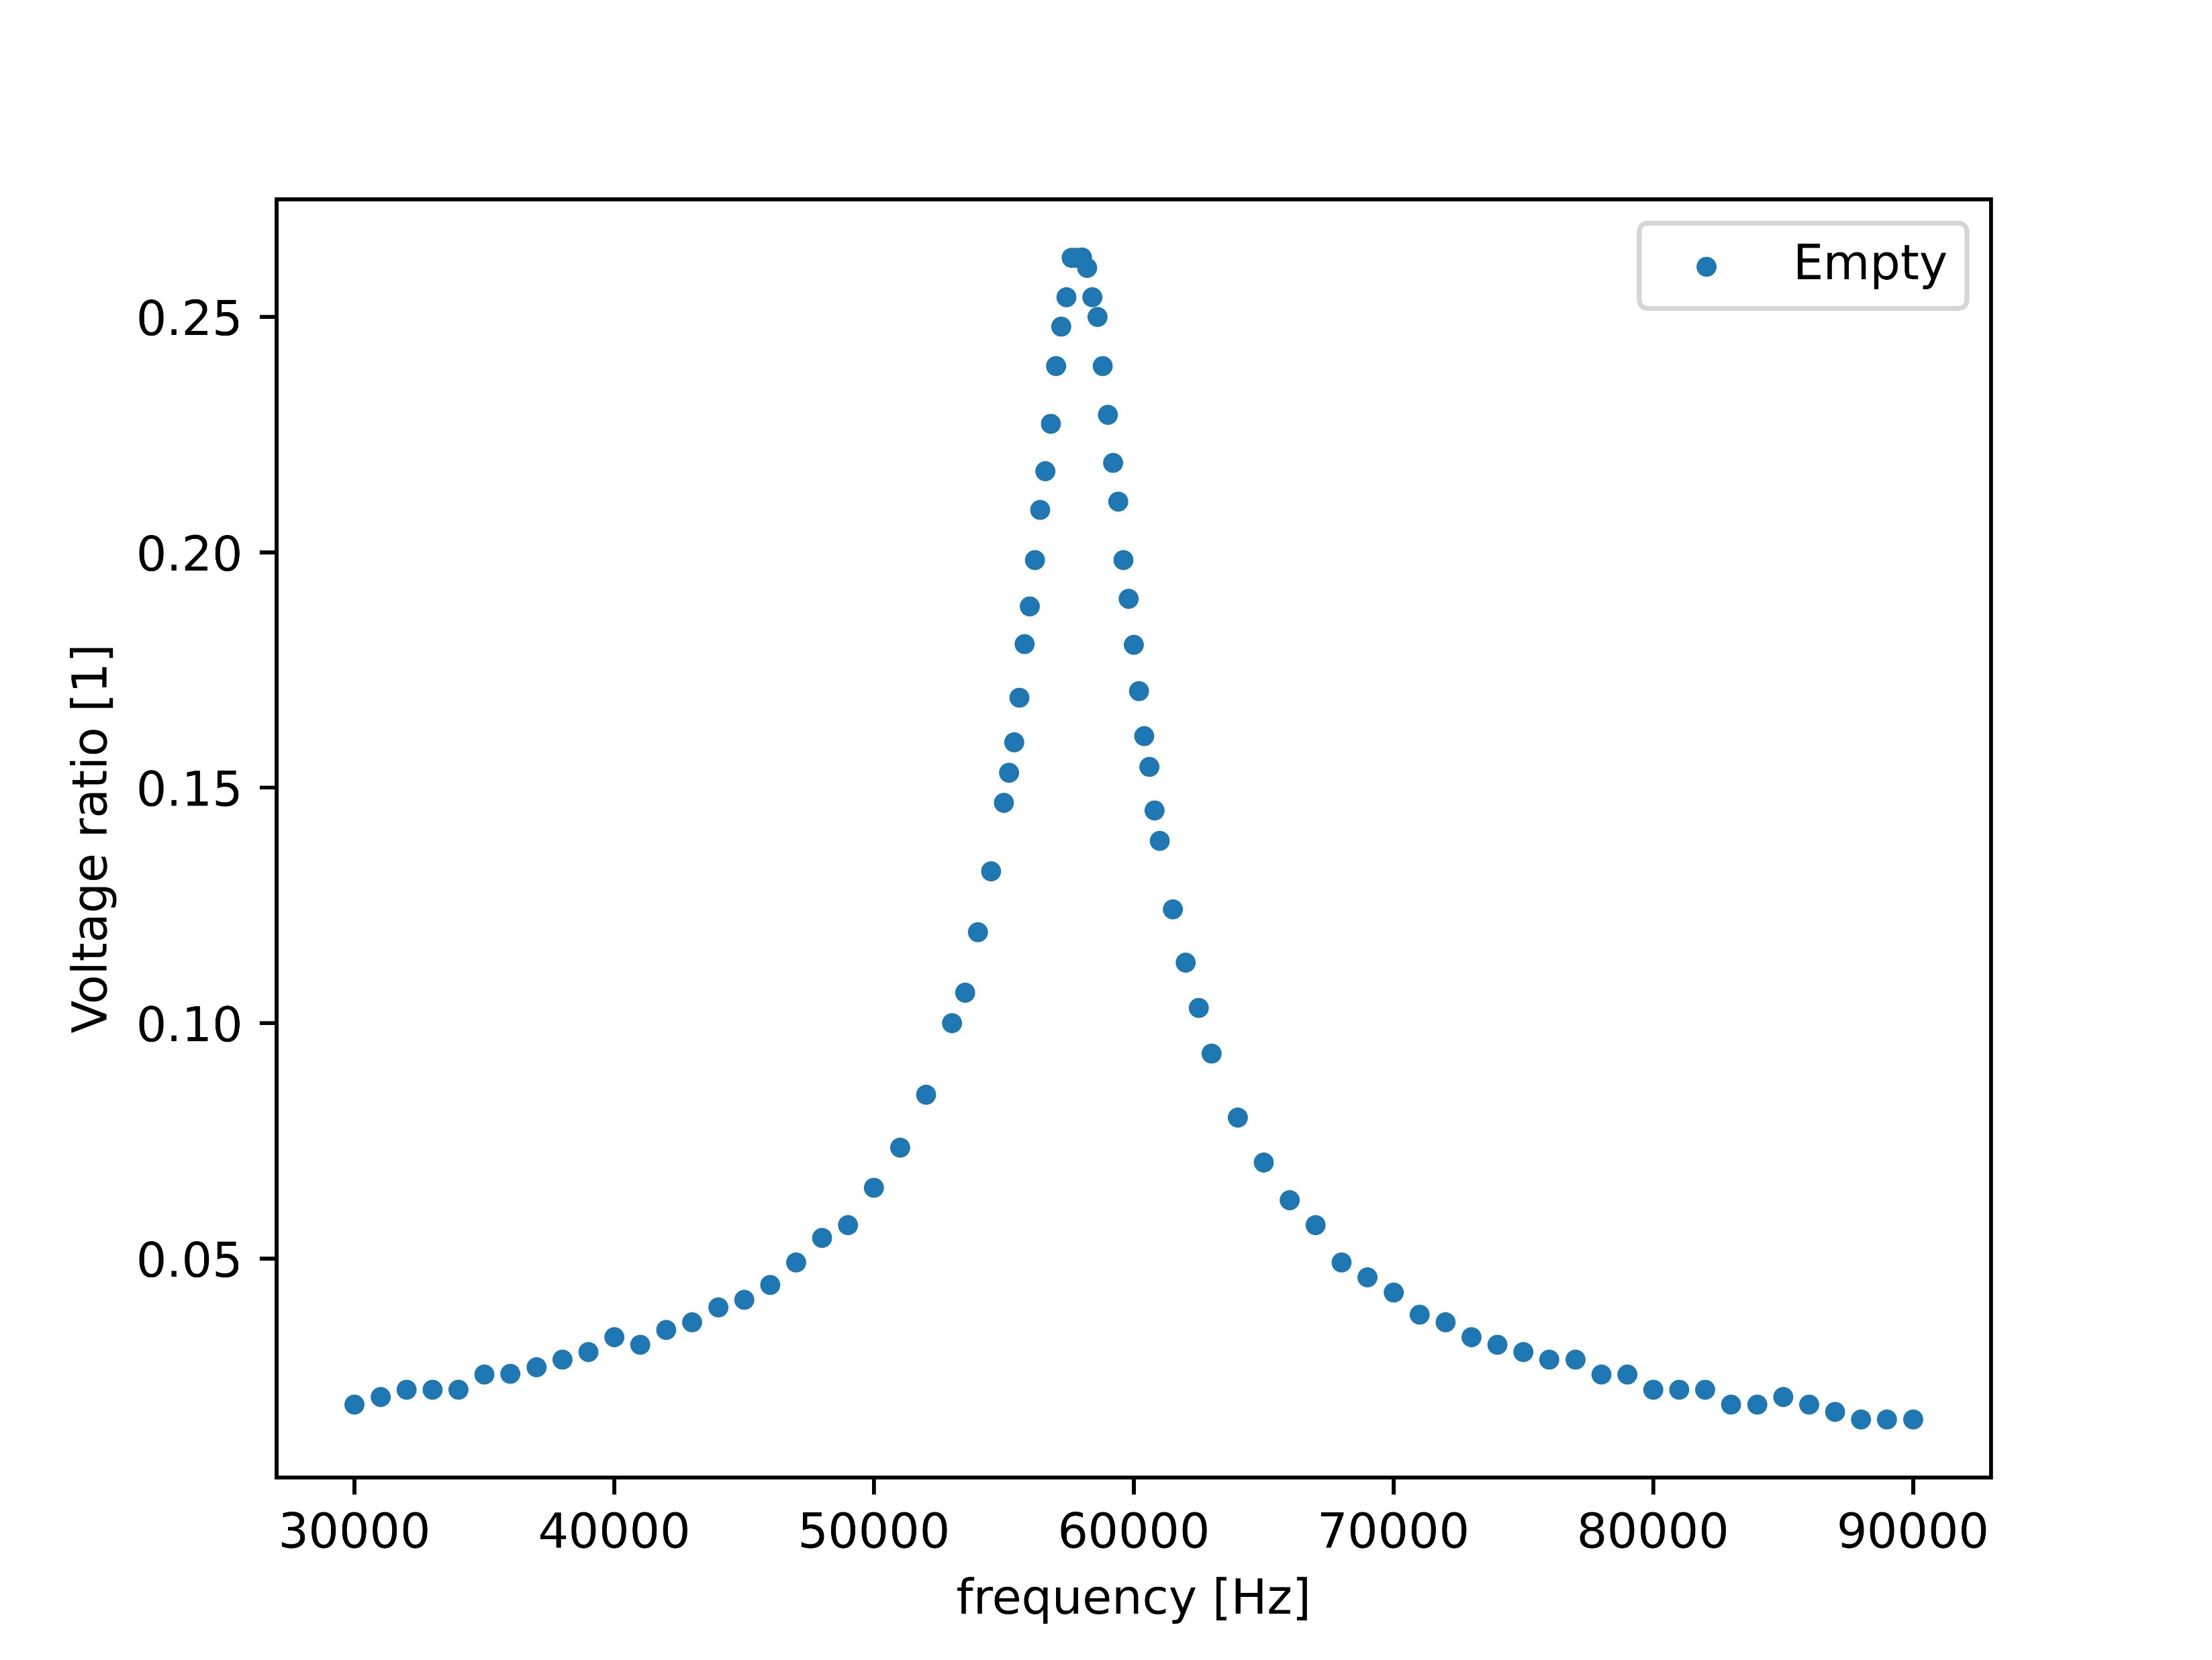
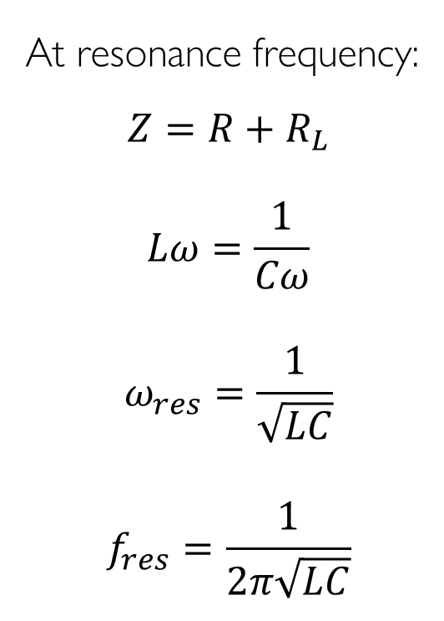


Voltage ratio graph
At resonance frequency:
$$Z=R+R_{L}$$
$$Lω=\frac{1}{Cω}$$
$$ω_{res}=\frac{1}{\sqrt{LC}}$$
$$f_{res}=\frac{1}{2π\sqrt{LC}}$$
$$\frac{R}{\sqrt{{\left(R+R_{L}\right)}^{2}+{\left(Lω−\frac{1}{Cω}\right)}^{2}}}$$
$$f_{res}$$
Notes:
R-hez nem hozzáadni az R0-t !!! – jobban fittel ? – plot legyen!

Slide 9




Change of L and R_{L}
$$\frac{U_{R max}}{U_{S}}$$
$$∆R_{L}$$
$$∆L$$
$$f_{res}$$
Notes:
előzővel együtt? – csúcsmagasság képlet

Slide 10
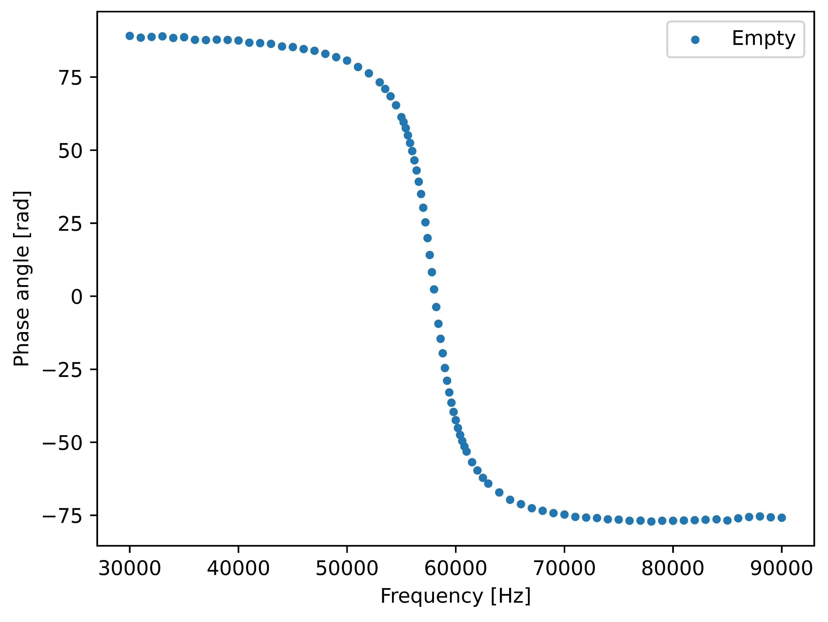


Phase angle graph
$$arctan⁡\left(\frac{Lω−\frac{1}{Cω}}{R+R_{L}}\right)$$
$$f_{res}$$
Notes:
the resonance frequency is the same – plot legyen! kell? – appendix

Slide 11
II. Measurement setup

Slide 12
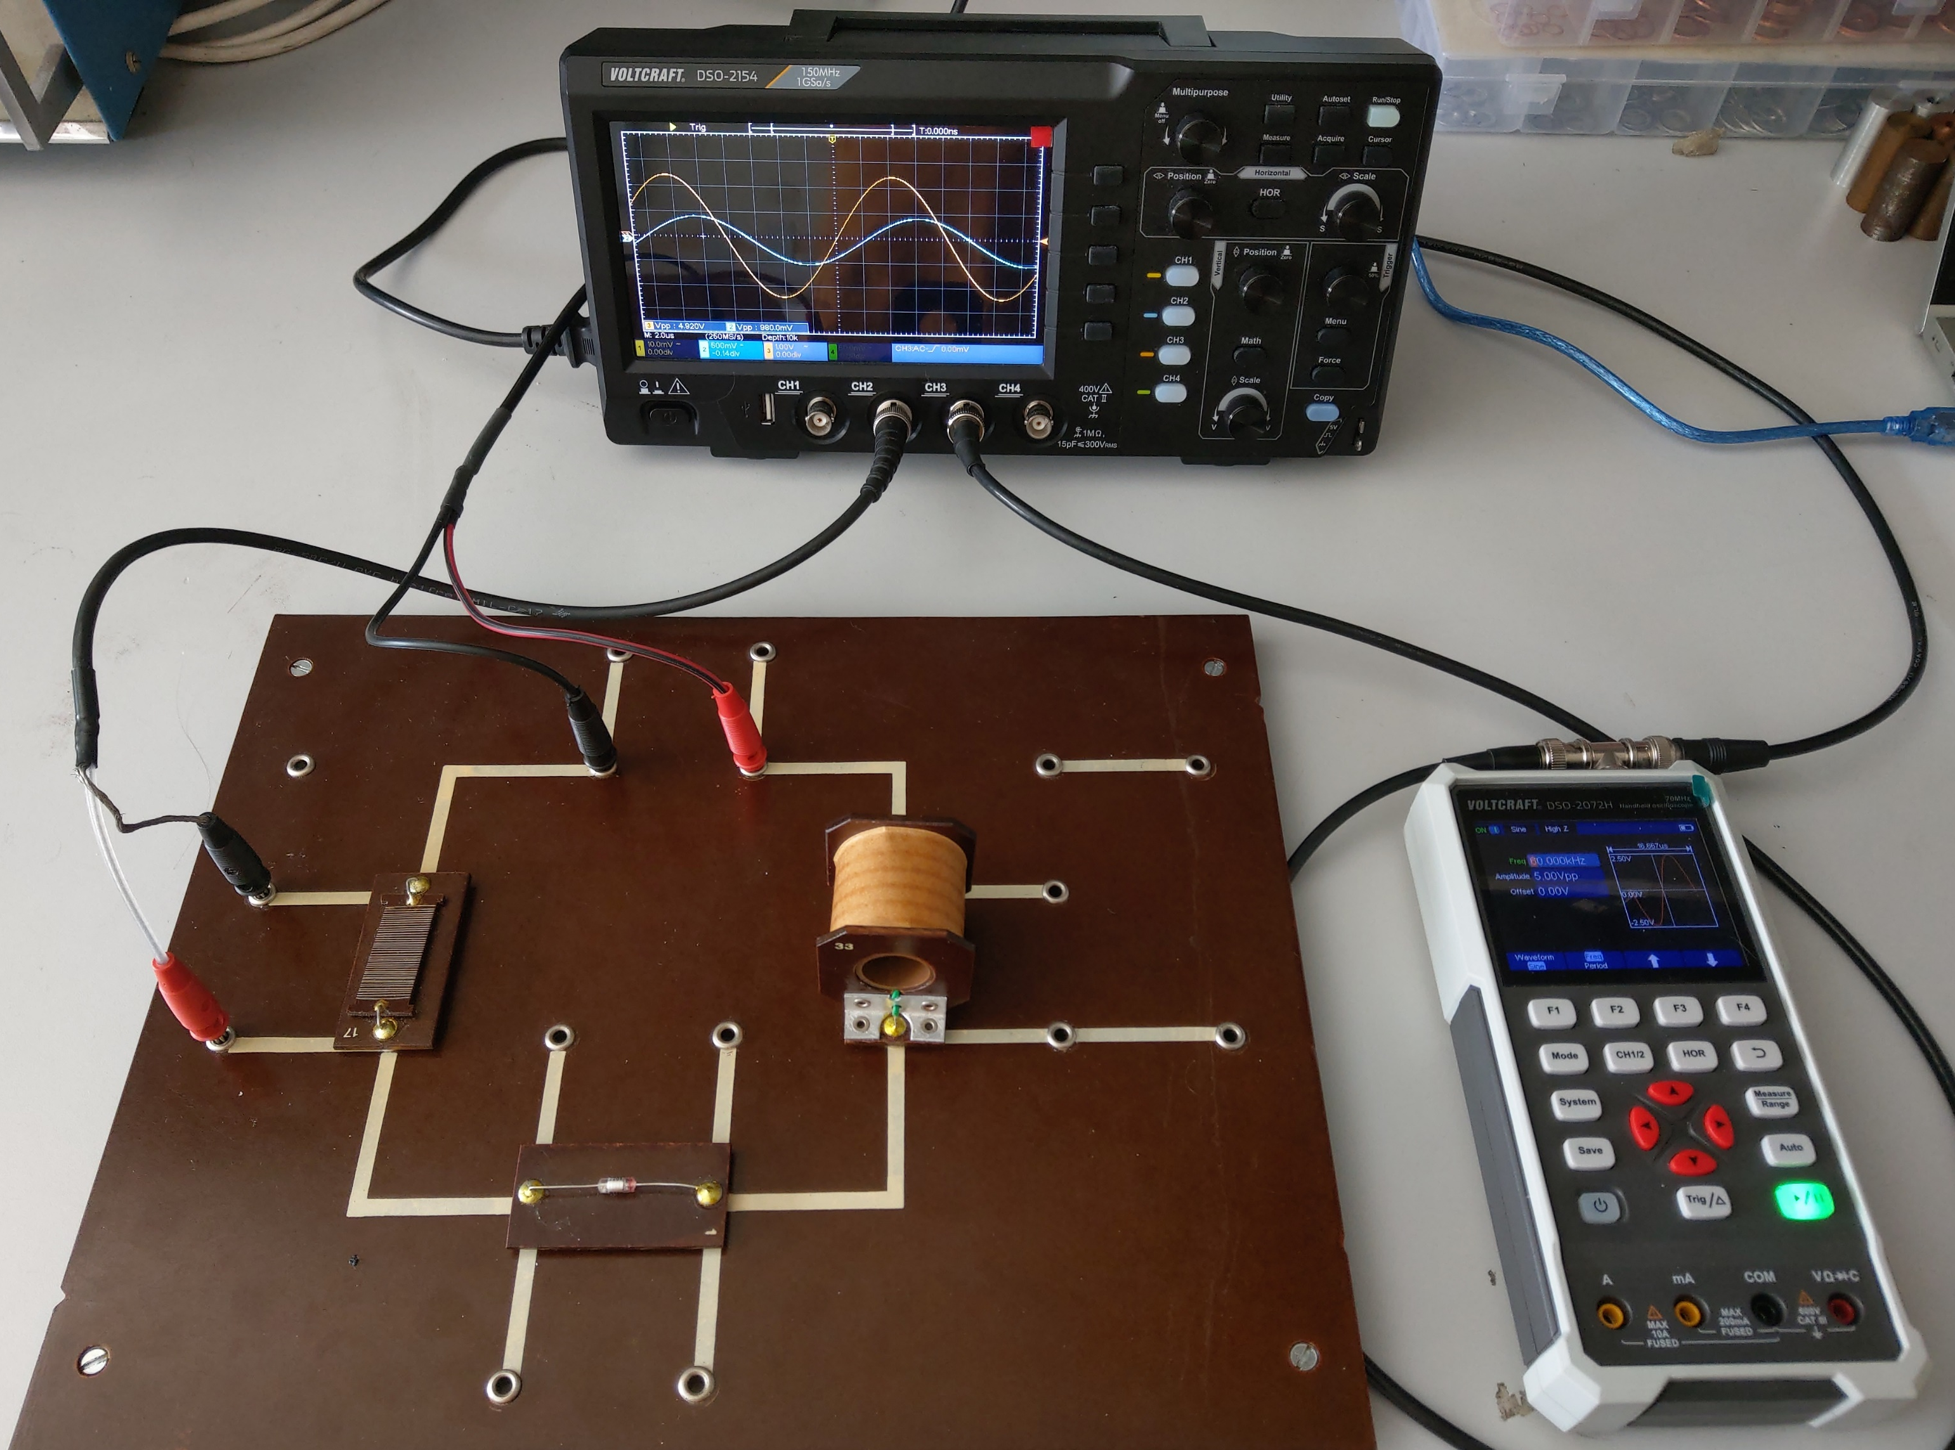
Components and equipment
Inductor:
N = 1200
L₀ = 0.028 H
R₀ = 16.4 Ω
l = 5 cm
d = 1.9 cm
C = 272 pF
R = 289 Ω
U = 5 V pk-pk (sinusoidal)
Notes:
több kondi és elllenállás

Slide 13
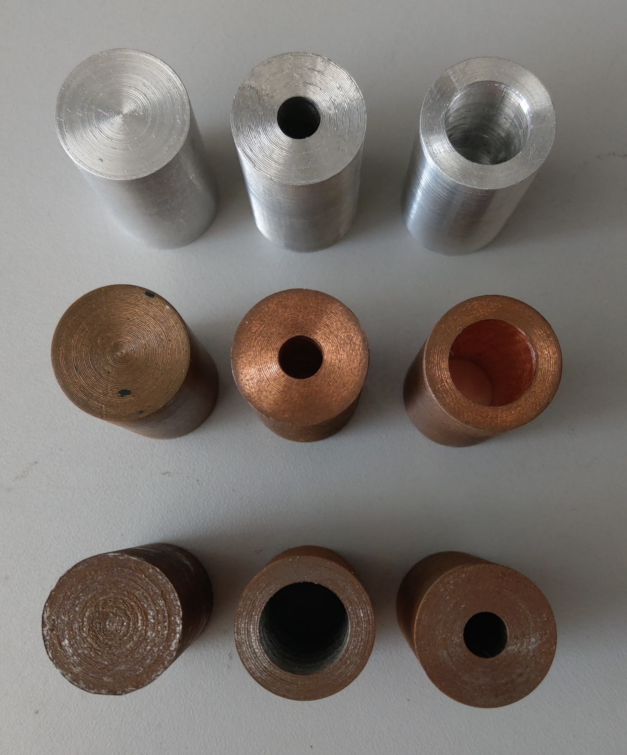
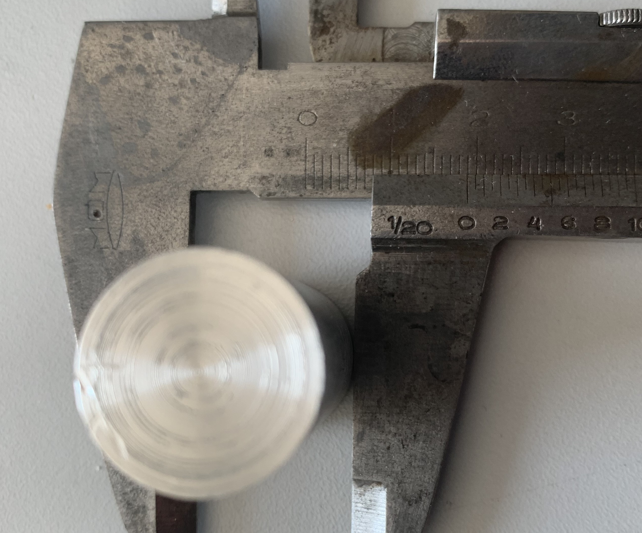
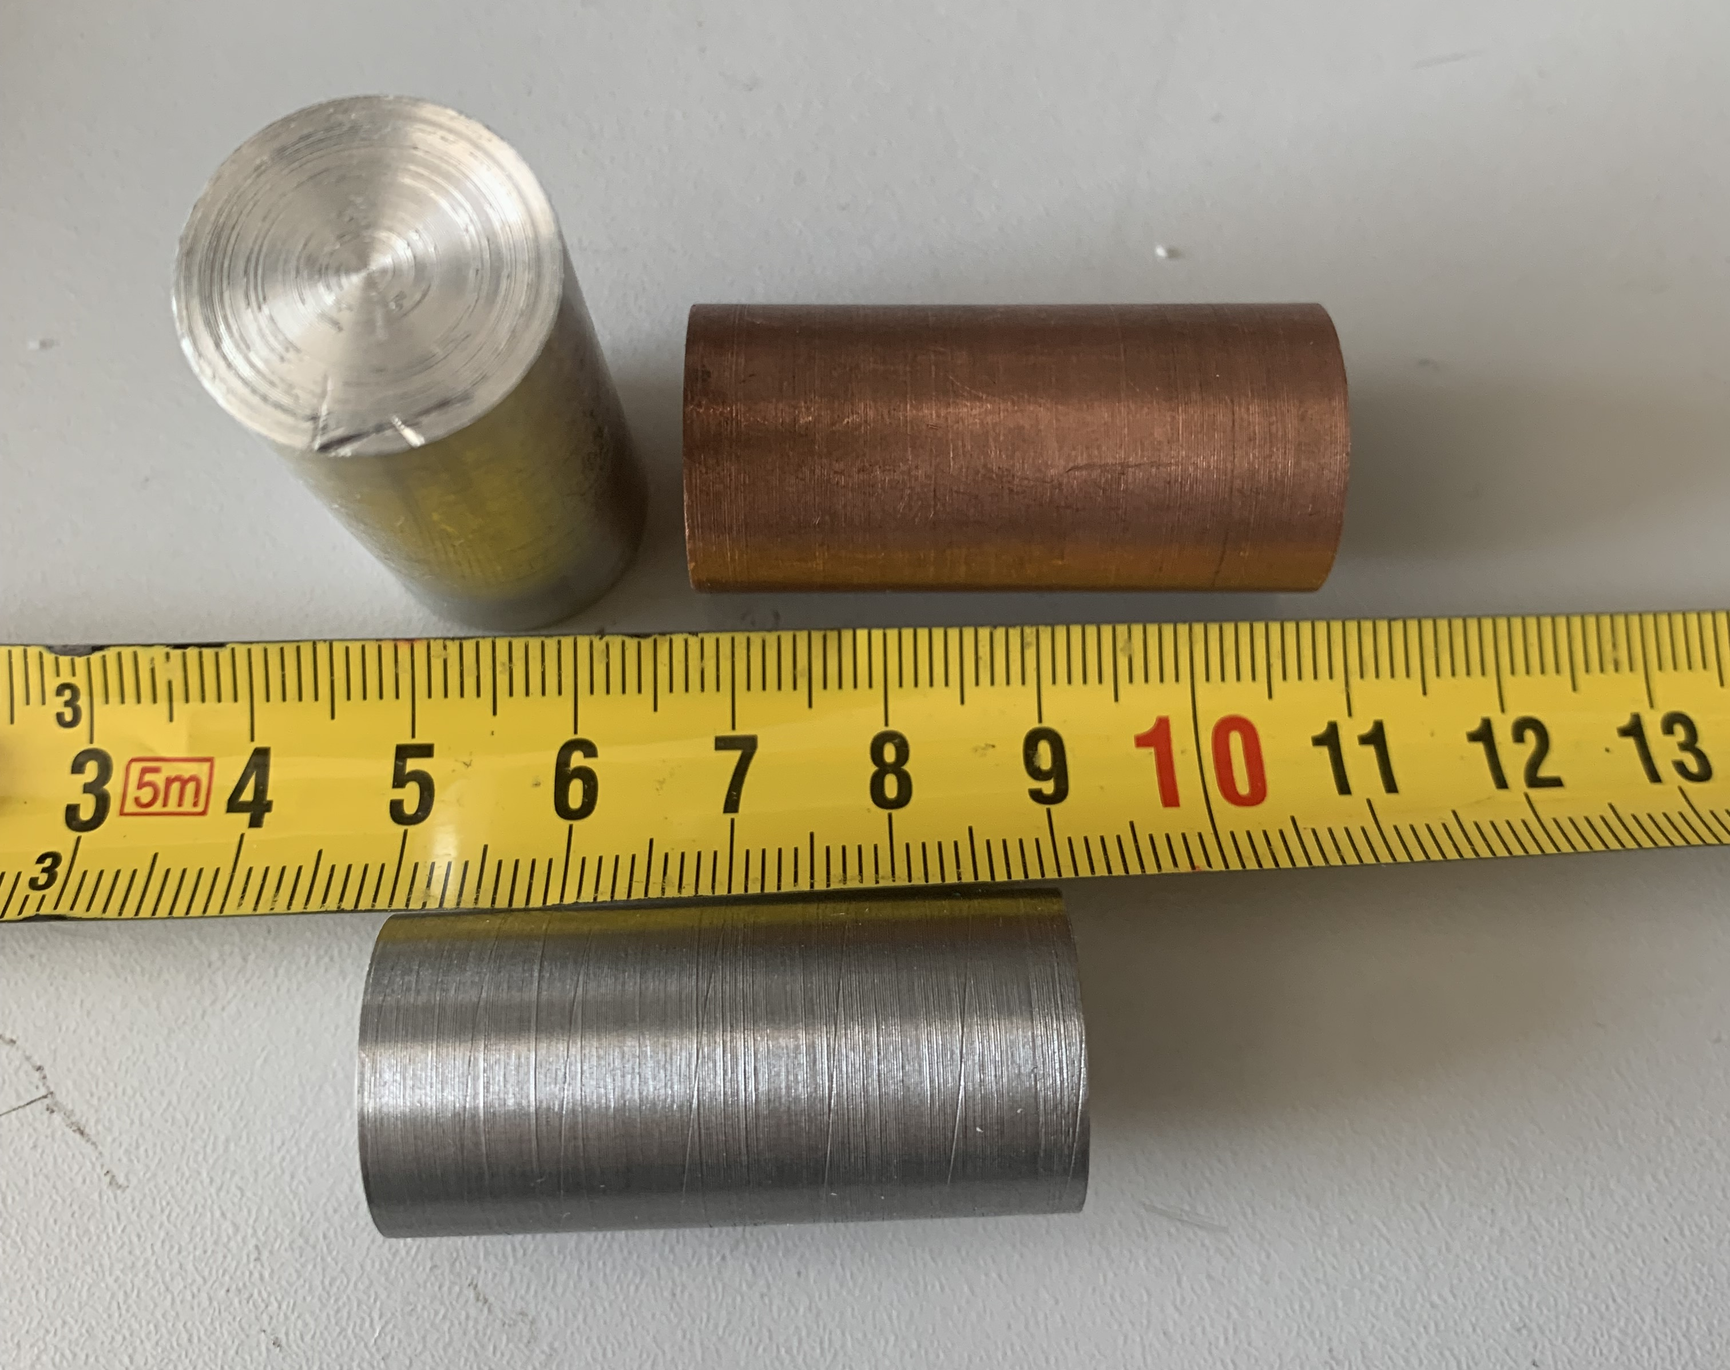
Rods
Rod materials:
Aluminium (Al)
Copper (Cu)
Iron (Fe)
Holes inside the rods
non-magnetic conductors
ferromagnetic

Slide 14
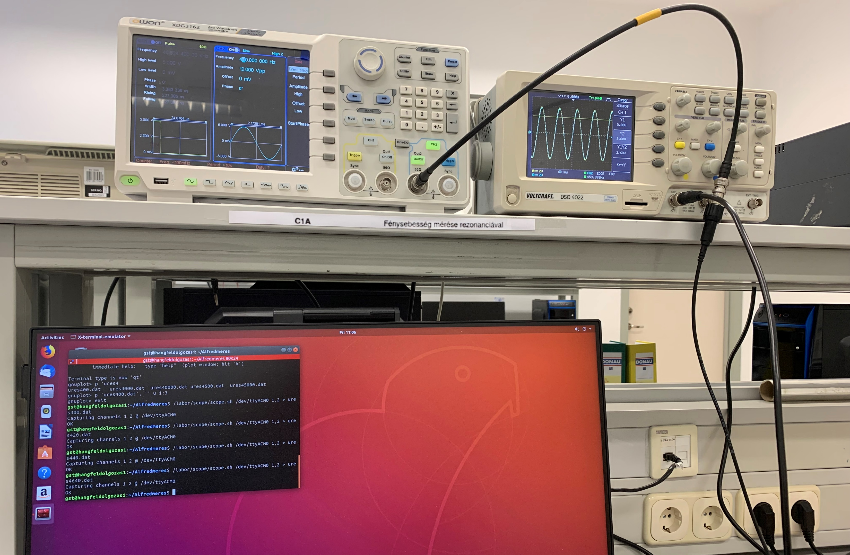
Instruments
XDG 3162 Function generator
DSO 4022 Oscilloscope

Slide 15
III. Results

Slide 16
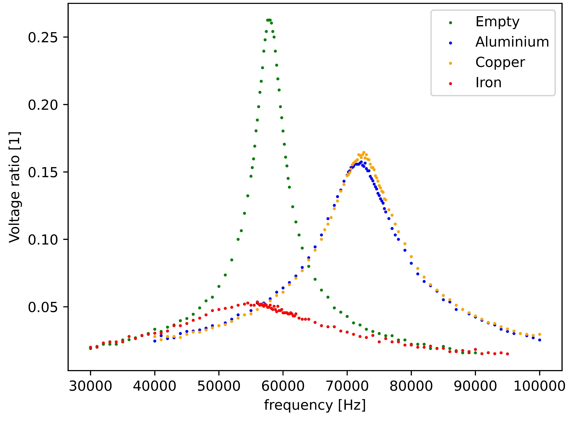
Curves for different materials
Material | Resonance frequency [Hz] | L [H]
Empty | 57 800 | 0,0278
Al | 72 300 | 0,0178
Cu | 72 500 | 0,0177
Fe | 56 200 | 0,0295
Notes:
új plottok, mik változnak, képlettel – beszélni a plotokról! – frekvencia függés bevezetése

Slide 17
How do the properties of the core influence L and R_{L}?

Slide 18
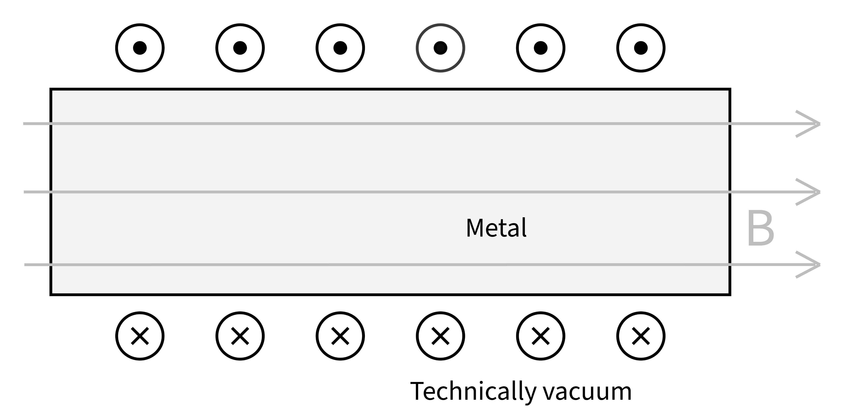
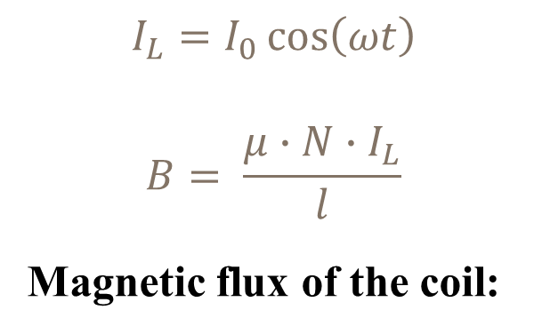
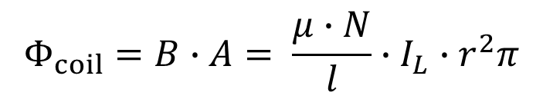
Magnetic field in the coil
(current out)
$$I_{L}=I_{0}\cos\left(ωt\right)$$
$$B= \frac{μ∙N∙I_{L}}{l}$$
Magnetic flux of the coil:
$$Φ_{coil}=B∙A= \frac{μ∙N}{l}∙I_{L}∙r^{2}π$$
(current in)
μ: permeability of rod , A: cross-section of rod
Notes:
mu kell?

Slide 19
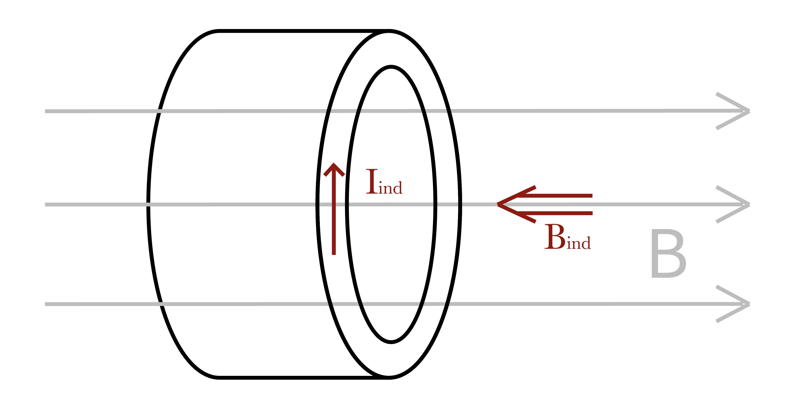

Eddy currents in the core
L
AC source → magnetic field constantly changes
Faraday’s law of induction:
$$U_{ind}=−N\frac{dΦ}{dt}=−\frac{μN^{2}}{l}r^{2}π∙\frac{dI_{L}}{dt}$$
induced Eddy-currents
Lenz’s law → oppose I_{L}
induce opposing magnetic field
concentric currents → B_{ind} grows towards the center

Slide 20
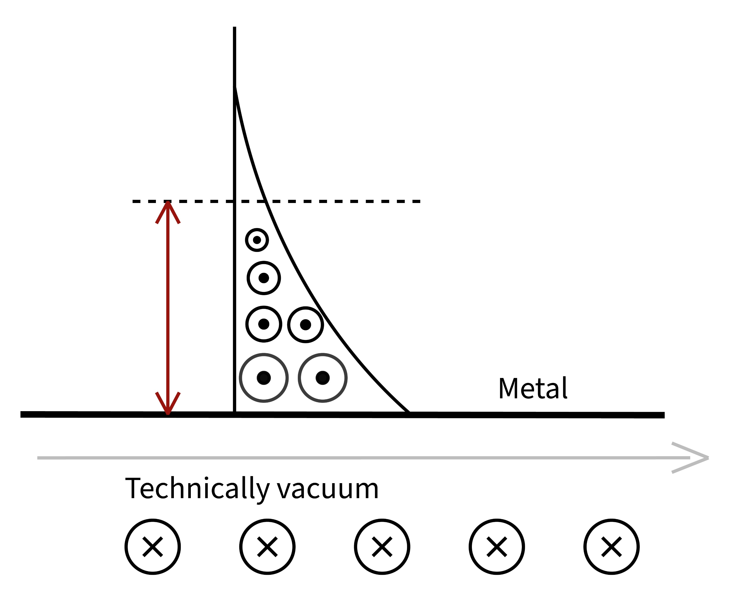
Skin effect
grafikon a különböző B terekről
B_{ind} weakens the original B →
total B exponentially decays – decay rate is the skin depth
magnetic field can only penetrate in the rod until a given distance
Sci-Hub | Formulas for the Skin Effect. Proceedings of the IRE, 30(9), 412–424 | 10.1109/jrproc.1942.232015
opposite Eddy-currents
B = B₀cos(ωt)

Slide 21
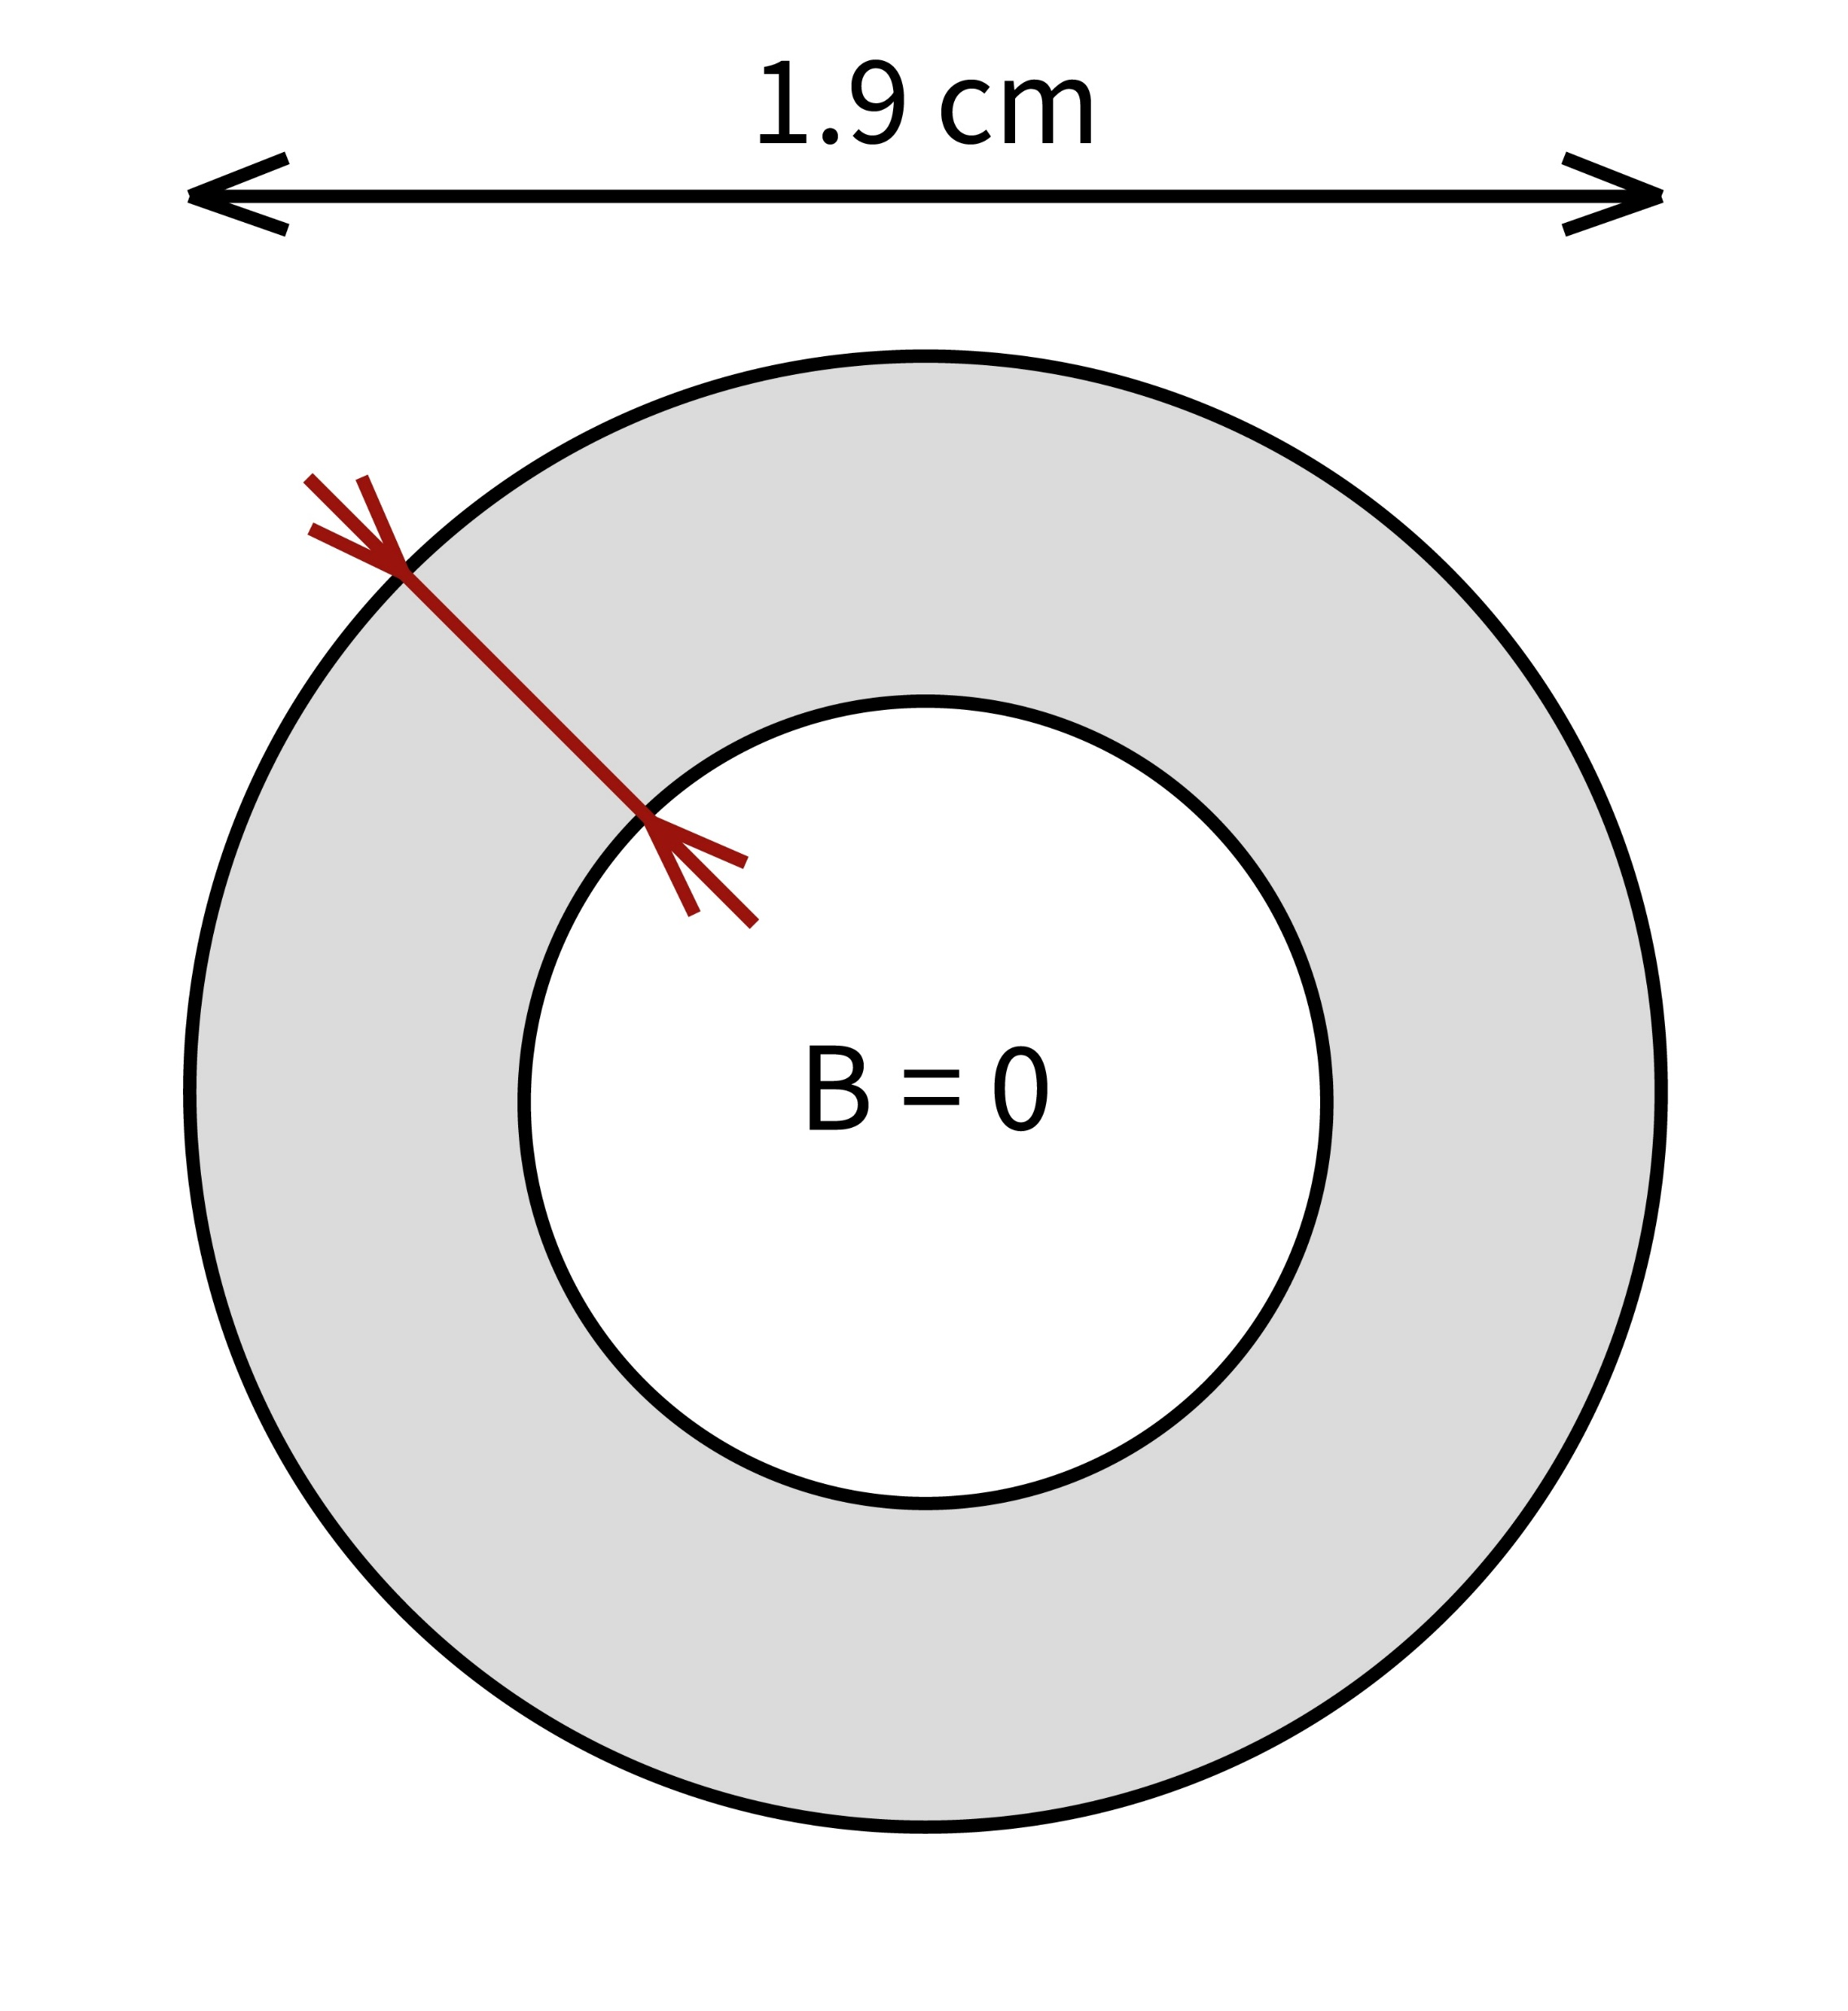





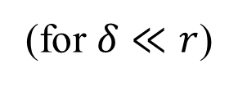
Skin-depth δ
Eq for B decay – delta definition (decay rate)
Fluxus kiintegrálva?
Effective magnetic flux:
$$δ=\sqrt{\frac{2}{ωμσ}}=\sqrt{\frac{2ρ}{ωμ}}$$
$$d=2r$$
δ
(for $δ≪r$)
$$B=0$$
$$Φ_{total}=Φ_{coil+eddy}=B∙A= \frac{μ∙N∙I_{L}}{l}∙(2rπ∙δ)$$
$$B≠0$$
σ: conductivity of rod ; ρ: resistivity of rod
Notes:
EGYENLETEK!!!

Slide 22
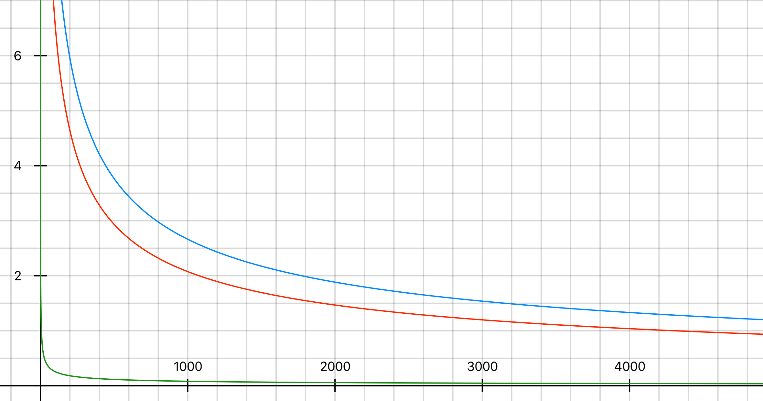
Skin depth (example)
δ (mm)
Measuring range:
8 000 – 100 000 Hz
Aluminium
Copper
Iron
f (Hz)
Notes:
szebb plot – delta eq.val

Slide 23
Experiments – hole in the core
Notes:
új plotok

Slide 24
V. Inductivity and resistance of coil

Slide 25





Inductivity
képek
$$L_{empty}=\frac{μ_{0}N^{2}r^{2}π}{l}$$
$$N\frac{dΦ_{tot}}{dt}=L \frac{dI}{dt}$$
(electromagnetic induction)
$$N∙\frac{μ_{0}μ_{r}NI}{l}∙2rπδ=L∙I$$
$$L=\frac{μ_{0}μ_{r}N^{2}2rπδ }{l}=\frac{μ_{0}μ_{r}N^{2}2rπ\sqrt{\frac{2}{ωμ_{0}μ_{r}σ}}}{l}=\frac{2\sqrt{2}πrN^{2}\sqrt{μ_{0}}}{l\sqrt{ω}}∙\sqrt{\frac{μ_{r}}{σ}}$$
electric and magnetic properties arise:
$$\frac{μ_{r}}{σ} =\frac{l^{2}L^{2}f}{{πμ_{0}d}^{2}N^{4}}$$
The same ratio can be expressed from the change of resistance of the coil – irrelevant.
Notes:
permeability and conductivity can’t be separated

Slide 26




Currents in the core
I_{L}
$$R=ρ\frac{l_{wire}}{A_{wire}}$$
I_{tube}
$$R_{tube}=ρ\frac{2rπ}{δ∙l}$$
$$I_{tube}=N∙I_{L}$$

Slide 27



Heat loss
resistance of the wires is constant (a bedugáskor!) →
Joule-heating in the core:
$${δP}_{core}=I_{tube}^{2}∙R_{tube}=I_{L}^{2}∙∆R_{L}$$
$$ρ\frac{2rπ}{δl}∙{\left(NI_{L}\right)}^{2}=I_{L}^{2}∙∆R_{L}$$
$$∆R_{L}=ρ\frac{2rπN^{2}}{δ∙l}$$
$$R_{tube}=ρ\frac{2rπ}{δ∙l}$$
$$I_{tube}=N∙I_{L}$$
$$∆R_{L}\sim \sqrt{\frac{μ_{r}}{σ}}$$
Notes:
nem az a delta

Slide 28


Electric and magnetic properties
From L:
$$\frac{μ_{r}}{σ} =\frac{l^{2}L^{2}f}{{πμ_{0}d}^{2}N^{4}}=kL^{2}f\sim \frac{1}{f}∗∗3$$
Constant for the coil:
$$k=8,46∙{10}^{−7}$$
From deltaR:
Notes:
A*m / V*s odaírni MÉRTÉKEGYSÉG!!!

Slide 29
VII. Comparison, accuracy

Slide 30

Comparison
literature range
measurements
Notes:
különböző módokat más-más dián?

Slide 31
Accuracy
különböző paramétereknél hogy javul/romlik az eredmény

Slide 32
VII. Summary

Slide 33




Summary
Procedure:
Measure both peak voltages and the phase
Calculate L and R_{L} through curve fitting
Solve the resulting equation system
$${ω_{res}}^{2}\sim \sqrt{\frac{σ}{μ_{r}}}$$
$$\frac{{U_{R}}^{max}}{{U_{T}}^{max}}\sim \sqrt{\frac{σ}{μ_{r}}}$$
$$∆R_{L}=ρ\frac{2rπ∗N^{2}}{δ∗l}$$
$$L=L_{empty}∗\frac{2δ}{r}∗μ_{r}$$

Slide 34






Summary
Thank you for your attention!

Slide 35
Structure
problem statement, basic physics
theory I – RLC circuit
RLC measurement setup
evaluation → L and dR
theory II – Maxwell, obtaining σ and μ
relevant params, prooving skin depth
comparison – limitations
summary – whole process

Slide 36
Appendix – electric and magnetic properties
Material | Relative permeability | Conductivity (S/m , 20°) | Temperature coefficient
Al | 1,000022 | 3,77 e7 | 3,9 e-3
Cu | 0,999994 | 5,96 e7 | 4,04 e-3
Annealed Cu |  | 5,8 e7 | 3,93 e-3
Fe (98% pure) | 5000 - 200000 | 1,03 e7 | 5 e-3
Steel | 100 - 38000 | 1,45 e6 – 6,99 e6
Sources:
Appendix 8: Electrical Conductivity of Selected Materials - An Introduction to Materials Engineering and Science - Wiley Online Library
Electrical resistivity and conductivity – Wikipedia
Permeability (engineeringtoolbox.com)

Slide 37
Appendix – sources
2560px-Inductor_symbol.svg.png (2560×640) (wikimedia.org)
capacitor-symbol.jpg (600×200) (wiltronics.com.au)
2560px-Resistor_symbol_Europe.svg.png (2560×1280) (wikimedia.org)
360_F_508722395_Pl3TdrRJjGBqpwcFETTLJf3xlWi9D09I.jpg (360×360) (ftcdn.net)
0 (976×385) (mtstatic.com)

Slide 38





Phasor diagram
Reactance and resistance – phasors
Impedance (vector sum):
φ angle – phase difference between U and I:
$$\left|Z\right|=\sqrt{R^{2}+{\left(X_{L}−X_{C}\right)}^{2}}$$
$$X_{L}=ωL$$
$$X_{C}=\frac{1}{ωC}$$
steady-state response
Notes:
érdekesebb, egyszerűbben érthető legyen, több BASIC physics

Slide 39


Equations – simple LRC theory
$$\frac{U_{R max}}{U_{S max}}=\frac{R}{Z}=\frac{R}{\sqrt{{\left(R+R_{L}\right)}^{2}+{\left(Lω−\frac{1}{Cω}\right)}^{2}}}$$
Ohm’s law
$$φ=arctan⁡\left(\frac{Lω−\frac{1}{Cω}}{R+R_{L}}\right)$$
geometry

Slide 40






Appendix – long rod
72 500 Hz
72 600 Hz
72 400 Hz
The ratio of voltages and resonance frequency should not change!
Notes:
mielőtt kifúrtuk…

Slide 41





Appendix – skin effect illustration

Slide 42
Appendix – proximity effect

Slide 43
Appendix – magnetic hiszterézis

Slide 44

Appendix – ferromagnetism vs. ferrimagnetism
Ferrite:
Relative permeability: 10 – 20000
very low conductivity
Ferrite | Iron Oxide Compound | Britannica
Ferromagnetism – Wikipedia, Ferrimagnetism – Wikipedia – 1948, Louis Néel

Slide 45


Electric and magnetic properties
Material | Resonance frequency [Hz] | L [H]
Al | 72 300 | 0,0178
Cu | 72 500 | 0,0177
Fe | 56 200 | 0,0295
Ratio ($μ_{0}/σ)$
$$1,938∙{10}^{−5}$$
$$1,922∙{10}^{−5}$$
$$4,138∙{10}^{−5}$$
$$\frac{μ_{r}}{σ} =\frac{l^{2}L^{2}f}{{πμ_{0}d}^{2}N^{4}}=kL^{2}f\sim \frac{1}{f}∗∗3$$
Constant for the coil:
$$k=8,46∙{10}^{−7}$$
Notes:
A*m / V*s odaírni MÉRTÉKEGYSÉG!!!

